Slide 1
Smart Grids: Algorithms and Digitalization for Efficient Energy Management
22 May, 2019
Evoluon, Eindhoven
dr. ir. Ballard Asare-Bediako
Snr. Researcher & Lecturer, HAN
Control Systems & Smart Grids
1

Slide 2
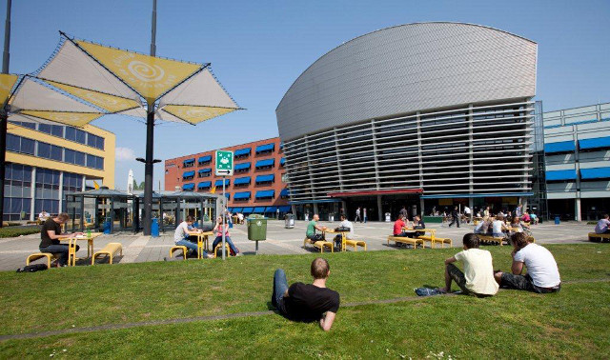
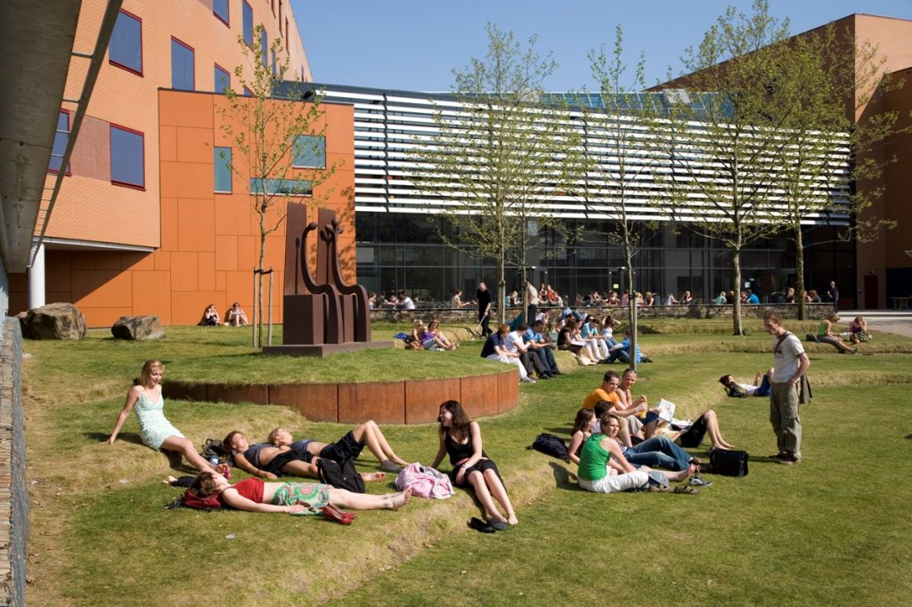
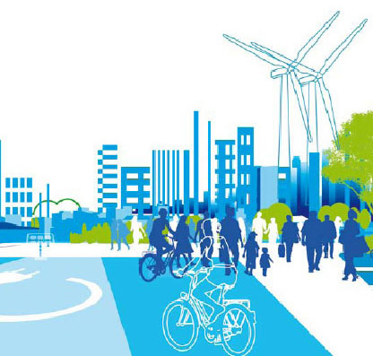
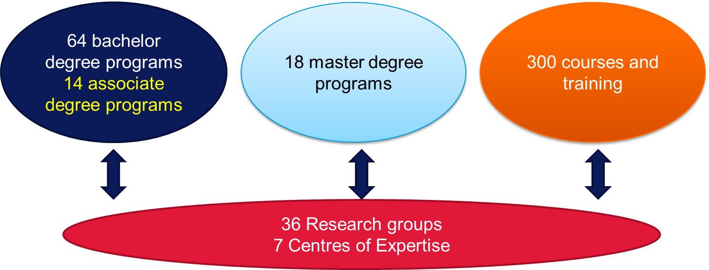
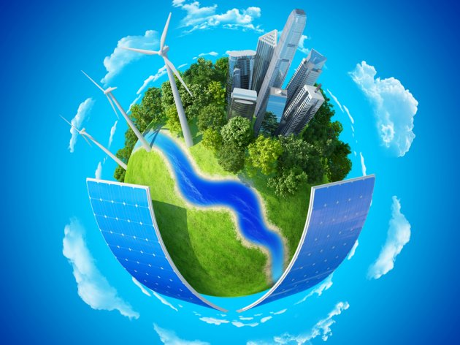
About HAN University of Applied Sciences
Two campuses
FOCUS POINTS
Health
Arnhem
Nijmegen
Smart Region
About 34,000 students (bachelor + master)
Sustainable Energy & Environment

Slide 3
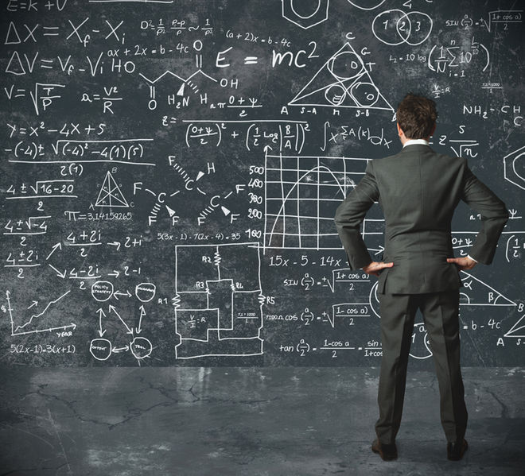
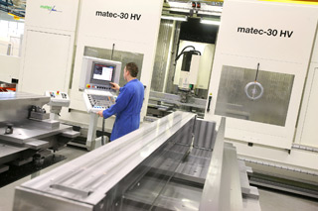
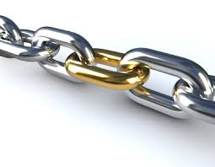
Applied Research
APPLIED RESEARCH
FACILITATORS
Development of Scientific Theories
Production of (New)Technologies

Slide 4
TALE OF ELECTRICAL ENERGY
Transportation System required
A form of Storage necessary
Conversion Needed
Demand and Supply Must Balance
(electricity supply and demand)
Not in the right form
Not at the right place
L
50 Hz
G
Not at the right time
G
L
Figure: The power system balance can be represented by a wheel, accelerated by generation (P) and decelerated by load (L)
Figure provided by J. Frunt
4

Slide 5
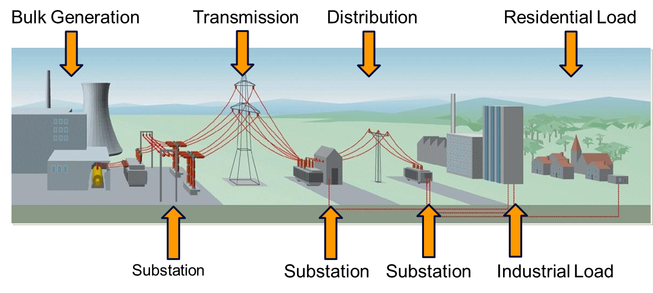
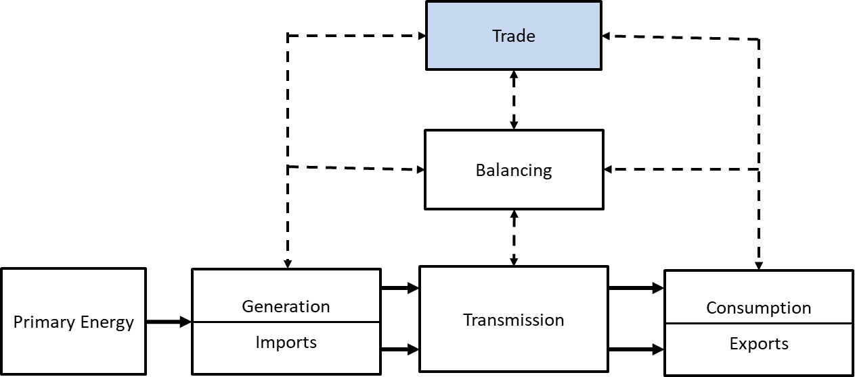
STRUCTURE OF THE POWER SYSTEM
The vertically integrated industry is unbundled leading to separate generation, transmission, distribution and trading/supply companies, each having specific tasks.

Slide 6
TODAY’S CHALLENGES
The world today faces many challenges of which a large
number are related to energy and it’s consumption
To name a few:
Global warming
Depletion of resources
Energy dependency of the economy
Population growth
Environmental awareness
6
Source: Marco C. Janssen

Slide 7
https://ec.europa.eu/jrc/en/efsi/energy-transition

Slide 8
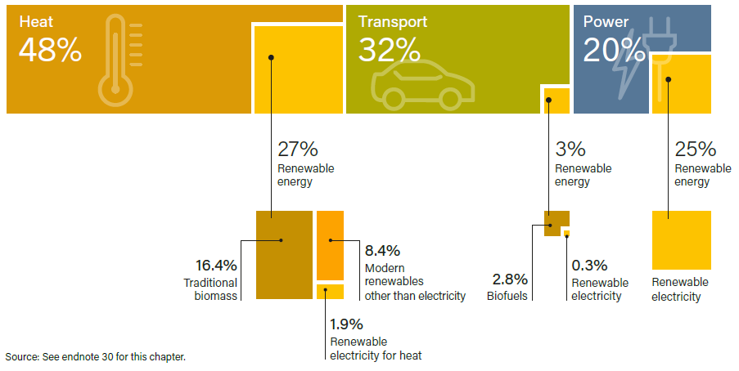
RENEWABLE ENERGY IN TOTAL FINAL ENERGY CONSUMPTION, BY SECTOR, 2015
Source: Dejan Ostojic

Slide 9
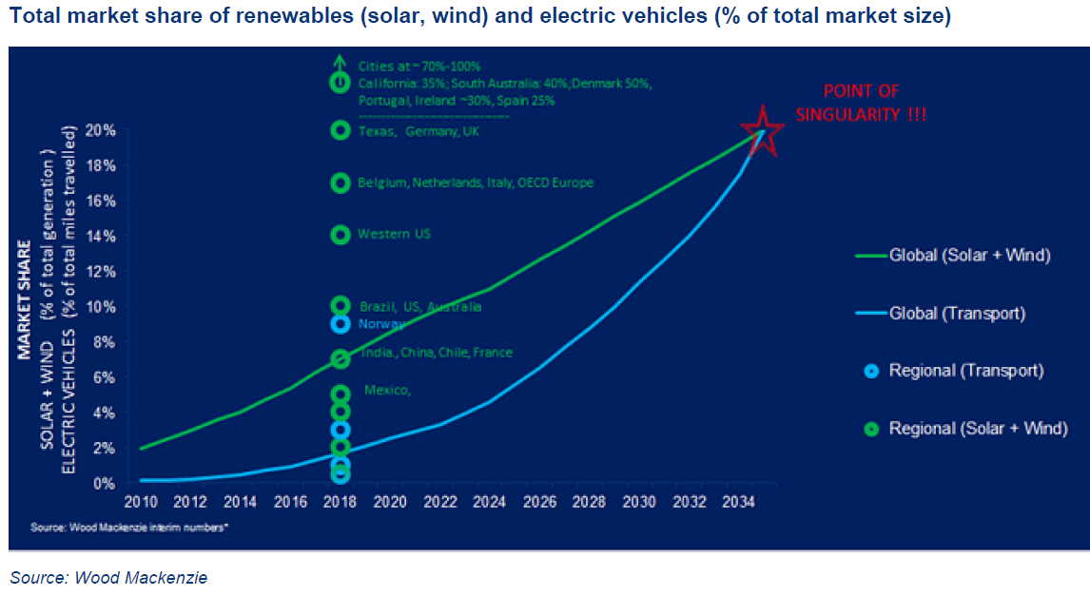
GLOBAL ENERGY TRANSITION (2015-2035)
Two drivers of GET: Renewables and Electrification:
Decarbonization of energy use requires “deep electrification”, particularly in transport and industry.
Decarbonization targets (particularly in the EU) will drive the transformation
Peak oil demand by 2035 and significant reduction in the use of natural gas thereafter.

Slide 10
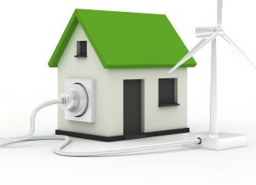
WHY ALL ELECTRIC?
(ALMOST) EVERYTHING CAN BE DONE WITH ELECTRICITY

Slide 11
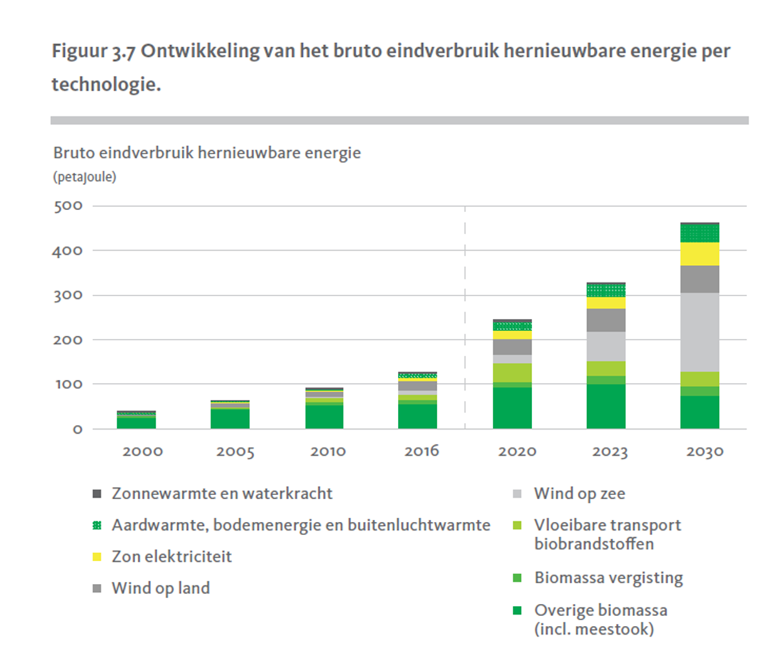
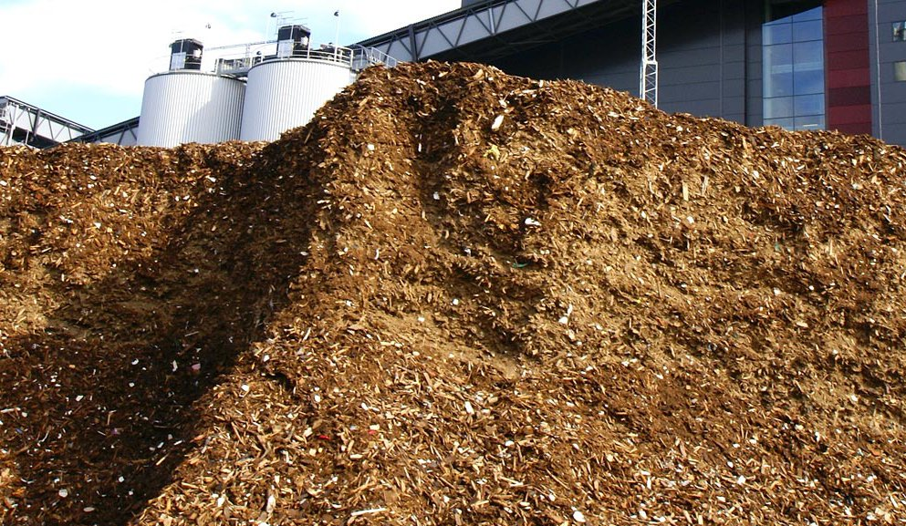
WHY ALL ELECTRIC (2)?
TO
INTEGRATE
MORE RENEWABLE ENERGY SOURCES
IN THE ELECTRICITY NETWORK.
Wind farms
Solar panels
Biomass

Slide 12
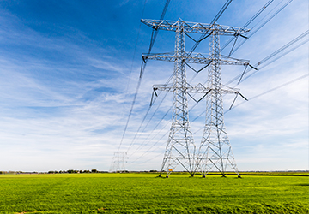
ALL ELECTRIC - WHAT ARE THE CONSEQUENCES FOR THE ELECTRICITY NETWORK?

Slide 13
OVERLOAD OF THE GRID
Source: dr.ir. P.H. Nguyen

Slide 14
European Technology Platform Smart Grids
SMART GRIDS
A Smart Grid comprises electricity networks that can intelligently integrate the behavior and actions of all users connected to it - generators, consumers and those that do both – in order to efficiently deliver sustainable, economic and secure electricity supplies.
14

Slide 15
SMART GRID – FROM GRID TO NETWORK
43
Source: Toward a Smarter Grid ABB’s Vision for the Power System of the Future

Slide 16
SMART GRID – ARCHITECTURE
Integrating Two Infrastructures
44
Source: EPRI Smart Grid Technologies and Challenges

Slide 17
OPTIMIZATION FOR SMART GRIDS
Electrical Energy Systems, TU/e, Nederland

Slide 18
DIGITALIZATION: AN ENABLING TECHNOLOGY
Digital power systems are considered as one of the most crucial technologies for reducing power consumption, and managing the increasing power system complexity
Source: DNVGL: Digitalization and the Future of Energy

Slide 19
DIGITALIZATION: AN ENABLING TECHNOLOGY [2]
Source: DNVGL: Digitalization and the Future of Energy

Slide 20
DIGITALIZATION IN THE POWER SECTOR – Data & Analytics
Source: IEA: Digitalization and energy

Slide 21
DIGITALIZATION IN THE POWER SECTOR – Connectivity
Source: IEA: Digitalization and energy

Slide 22
Conclusion
“Deep electrification” and renewables are key drivers for the global energy transition
Smart Grids (and associated optimization algorithms) are expected to guarantee the sustainable and secure supply of the power system and to satisfy the ever increasing electricity consumption .
Digitalization is a key enabler in the decarbonisation and decentralization of the electricity sector, reducing power consumption, and managing the increasing power system complexity.

